Slide 1
UCAS Evening for Parents – July 2022
Notes:
Is the first Head student of Pinner High School here this afternoon? I look forward to finding out!

Slide 2
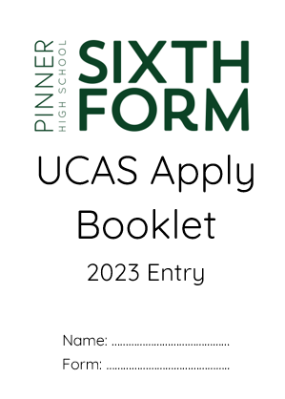
Everything a student needs to get started is in this booklet You now have a copy too

Slide 3
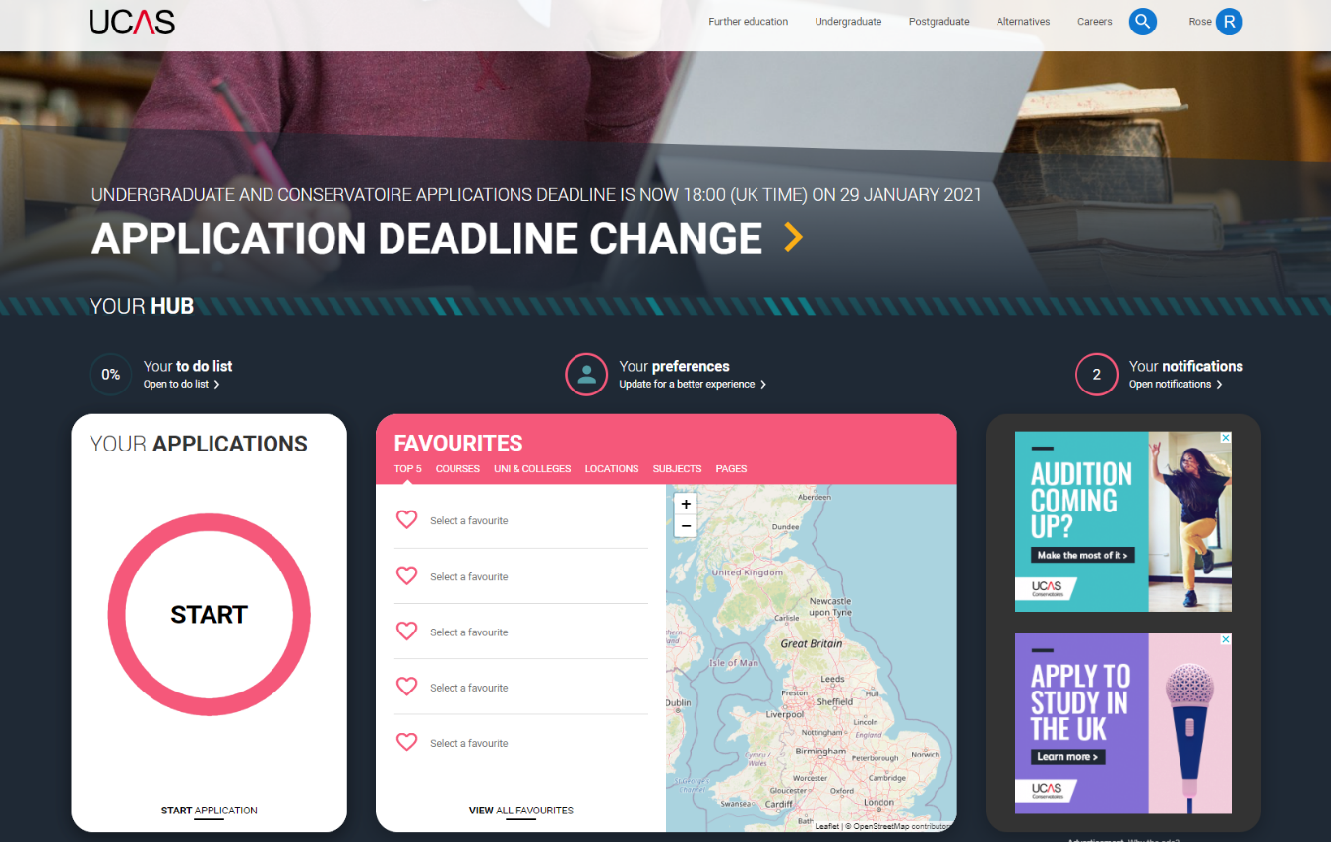
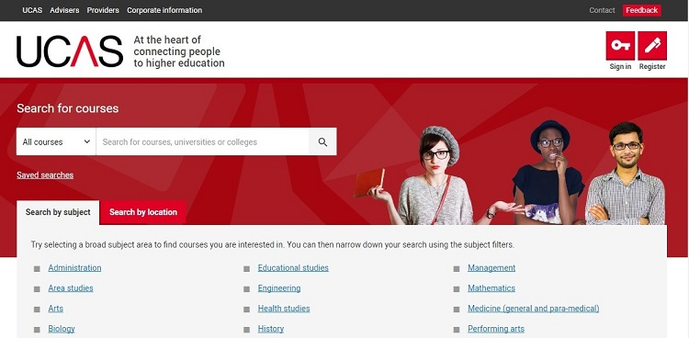
What is UCAS?
UCAS facilitate student applications to university alongside schools
Schools do not deal with universities directly, unless it is to inform them of extenuating circumstances post-application
It costs £27 (this year) to apply to UCAS. Students in receipt of our 16-19 bursary have this cost covered by school

Slide 4
What does the UCAS form involve?
The UCAS form collects information about students, their qualifications, current courses and university choices (5 choices)
Students upload details in addition to a personal statement of no more than 4000 characters
A nominated teacher (Mr Pandya/Miss Bruck/Ms Nelson) also uploads a reference of no more than 4000 characters before sending

Slide 5
The UCAS timeline
Applications formally open in September 2022, but students have logged into UCAS today
Deadlines for medicine, dentistry, vet science and Oxbridge are earlier (15th Oct)
Students sit tests for these course either before (UCAT) or after (BMAT, TSA etc)
The absolute final UCAS deadline is 15th January
It is our aim that all UCAS forms be sent by mid to late November 2022
Applications sent after the January deadline do not have equal consideration

Slide 6
The in-school timeline
August/Summer break
Students draft personal statements; wider-reading more work experience
6th September 2022
Earliest date that UCAS form can be sent
November 2022
In-school deadline
15th Oct 2022
Competitive entry deadline
25th Jan* 2023
Final UCAS deadline
July
Higher education day
@PHS
Drafting and re-drafting personal statements

Slide 7
Do not worry…
A student cannot accidentally send a UCAS application to UCAS/universities
It can only be sent by teachers with certain access permissions
In the highly unlikely event a mistake is made, things can be rectified and amended after sending

Slide 8
Making choices
Students get 5 choices
If they opt for Medicine or Dentistry, students can only apply for 4 courses (and 1 back-up)
You cannot apply to Oxford and Cambridge
Your choices must all be for the same subject/field (broadly-speaking)

Slide 9
Offers after sending: How long will students have to wait?
Students will receive offers soon after sending, but some universities take longer. It's just the way it is.
Students will receive notifications that their UCAS status has changed – they check UCAS to see if they have offers/rejections

Slide 10
What is included on the UCAS form
Personal details | Names, address, nationality , contact details | Students
Finance and funding intentions | Students must indicate how they will be paying for their education
Educational details and qualifications | Schools attended, qualification earned (including external) and current courses
Any employment details | Part-time jobs (if applicable)
Course choices | Students get 5 choices; these should be consistent and at 5 different universities
Personal statement | An overview of the student’s academic strengths and why they want to study what they want to study
Predicted grades | For each A Level course | Sixth Form Team
Reference | Written by Sixth Form staff; and endorsement of the student’s suitability

Slide 11
The Personal Statement
Personal statements are how students show their passion, talent and aptitude for their chosen subject
It demonstrates evidence of wider reading and learning in the statement
It is not a biography – it is supposed to show the admissions tutors that students know what to expect and that they are prepared for higher level study
Students demonstrate how their A Level courses have prepared them for degree level study

Slide 12
The reference
Features information about student achievement
in their subjects
in the wider school
outside of school
It is wholly positive
Teachers contribute paragraphs about their students’ academic abilities and strengths
Mr Pandya/Miss Bruck/Ms Nelson will ‘finesse’ the reference and add personal information, extenuating circumstances etc
We do let students hear their reference – but we will not provide copies.
If a student wants their teacher/referee to highlight something in particular they will be able to.

Slide 13
Preferences over who writes the reference…
Not really necessary
The reference is predominantly academic in nature and these comments are given by the subject teachers of your son/daughter
The remaining information is shaped by their tutor and the sixth form team in conjunction with the student

Slide 14
Predicted grades
Predicted grades are HOLISTIC – they take into account a range of factors
Mock exam grades (Summer 2022)
GCSE performance
ALPS benchmark grades
Progress through Y12 and into Y13
Capacity for sustained improvement
Intended courses of study and entry reqs

Slide 15
Predicted grades
Fundamentally, grades need to be realistic – but we won’t do students a disservice
Would it be right to predict a student an A grade if they had never achieved an A grade?
A* predictions will be based on cumulative achievement of results of over 90%
At the end of the day, if a student gets an offer for their top choice course, they need to get the grades at the end…

Slide 16
Principles for predicting grades (from UCAS)
Predicted grades should be:
in the best interests of applicants
aspirational but achievable determined by professional judgement – your expertise and experience are vital in informing predictions
data-driven
finalised by the point of submitting an application
affected by student, parental, guardian, or carer pressure
influenced by university or college entry requirements or behaviours
affected by student behaviour or background

Slide 17
When will students find out about predicted grades?
In September, prior to sending their applications.
Students will sit down with a member of the sixth form team to discuss their predicted grades.

Slide 18
Risks of inflating predicted grades
An applicant may receive an offer(s) they are unlikely to meet, leading to disappointment on results day.
Applicants might gain admission to a course which they cannot succeed in – choosing the right course is a very important decision as they will be investing a lot of time, money, and effort, and it can be difficult to change.
If a university or college has reason to believe that a predicted grade is grossly inaccurate, they retain the right to withdraw any offers.

Slide 19
When do students accept offers?
It depends on when they have received all of their responses
If they receive all offers by January, they can reply in January
However, most students wait until March/April time
UCAS sets the ‘reply by’ deadline each year

Slide 20
What happens when you have all of your offers?
You choose..
Your ‘Firm’ choice (1st choice)
You ‘Insurance’ choice (back-up)
Your insurance offer should have lower entry requirements than your firm choice…because it’s your safety net.

Slide 21
Example…
Student A has received 4 offers…
UCL – History (AAA)
Nottingham – History (AAB)
Birmingham – History (AAB)
Sussex – History (ABB)
They decide to make UCL their Firm choice and Sussex their Insurance choice
Please note you only make a maximum of two choices after receiving your offers

Slide 22
What if a student does noes not get any offers?
This is rare
UCAS automatically triggers something called ‘Extra’ which allows students to make one more choice (to a university/course they have not received a rejection from)
Students can also apply for places through clearing after their results

Slide 23
What happens on results day?
If a student meets the entry requirements for their ‘firm’ (1st choice) course then students will automatically receive an acceptance – congrats!
If a student misses the grades for their ‘firm’ (1st choice) but gets the grades for their ‘insurance’ (back-up) courses then students will automatically receive an acceptance – congrats!

Slide 24
What if students do worse than they expect?
If a student misses the grades for their firm and insurance offers they can apply for places via ‘Clearing’
Clearing is a UCAS system which allows students to find courses with spare places
There are fantastic courses available through clearing, but not really for highly competitive courses like Medicine

Slide 25
STUDENT APPLIES
RECEIVES OFFER(S)
RECEIVES NO OFFERS OR REJECTS ALL OFFERS
STUDENT CONSIDERS OFFERS
STUDENT CAN ENTER ‘EXTRA’ AND GET ONE EXTRA CHOICE
STUDENT NARROWS DOWN CHOICES TO ‘FIRM’ AND ‘INSURANCE’
RECEIVES NO OFFER
AUGUST RESULTS DAY
STUDENT MEETS ENTRY REQUIREMENTS
STUDENT MISSES ENTRY REQUIREMENTS FOR FIRM
STUDENT MISSES ENTRY REQUIREMENTS FOR FIRM & INSURANCE
GETS PLACE AT ‘FIRM’ CHOICE
GETS PLACE AT ‘INSURANCE’ CHOICE
STUDENT ENTERS CLEARING OR CLEARING +

Slide 26
UCAS ‘Adjustment’ has been removed for this academic year

Slide 27
The parents’ role in the UCAS process
Support
Proof-reading
Checking/confirming details
Helping narrow-down options
Accompanying on open days
Spotting opportunities

Slide 28
What next?
The summer holiday is a chance to rest and recharge – but it’s also a chance to…
visit universities/cities
undertake wider-reading
participate in online courses
draft the personal statement

Slide 29
BUZZWORD
TRAILBLAZERS2023

